Slide 1
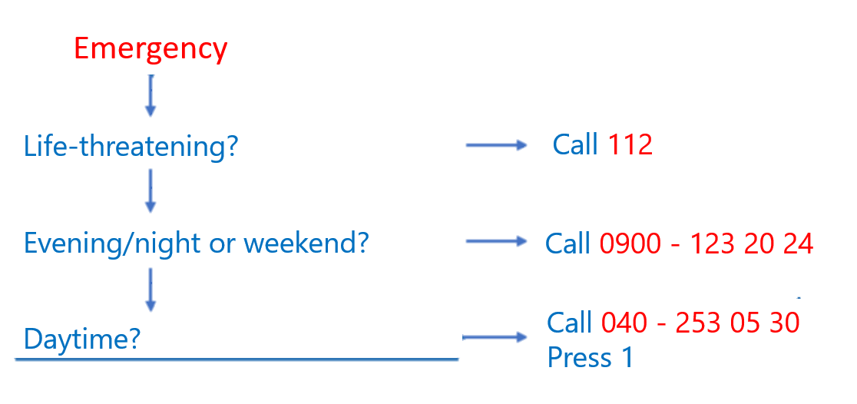
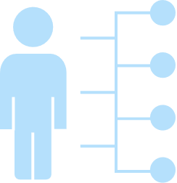
Welcome to Health Centre Huisartsenpraktijk Nijlandlaan An easily accessible health centre for all residents of Veldhoven north.
Huisartsenpraktijk Gielen
Nijlandlaan 63
5505 PB Veldhoven
040-2532650
Nijlandlaan 63
5505 PB Veldhoven
Making appointments
Emergency
For consultation you need to make an appointment.
You can reach the assistant by telephone, on the number listed at the top. Monday to Friday 08.00 – 17.00. (You can press 2 or don’t press a number and wait for the assistant.) Thursday you can call until 12. After 12 only call in case of emergency.
In case of an emergency press 1 at anytime.
If you call before 10.00 am, we aim to make an appointment the same day.
The assistant will ask questions to assess the urgency and the time needed for consultation.
An appointment is 10 minutes. If you have multiple problems you have to reserve more time.
If you are too ill to visit us, we can make a home visit. The assistant, together with the doctor, will decide if a home visit is needed and at what time.
040-2532650
Additional Services
About General Practitioners & Specialists
Repeat prescription: for chronic medication call our repeat-prescription line at the number listed at the top of this flyer, press 3.
Consultation assistant: The assistant at the health centre can perform the following examinations:
Nurse practitioners: We have three nurse practitioners specialised in cardiovascular disease, diabetes and the care for elderly. We also have a nurse practitioner specialised in mental health (psychological complaints).
To make an appointment with a specialist, you need a referral from the General Practitioner (GP) .
The GP is a medical doctor and is your first point of contact. He/she treats illnesses and provides preventive care and health education to patients. He/she can answer most of your general health questions and performs minor surgical procedures and standard examinations.
Lavage of the ears
Injections
Wart therapy
Urinalysis
Blood tests (CRP)
Periodic cervical smear test
Your GP serves as your link to other specialised services, such as other medical specialists or hospitalization if necessary.

Slide 2
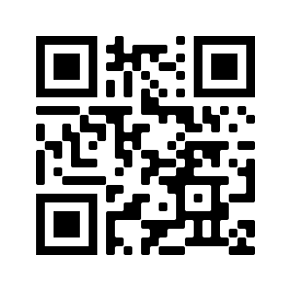
Frequently asked questions
How does the Dutch health care system work?
The general practitioner (GP), called a huisarts in Dutch, is your first point of contact in The Netherlands, even if you would prefer to see a specialist.
If you have a Dutch health insurance, the costs of your visit to the GP are paid for by your health insurer. The GP notifies your health insurer that you are registered in our practice.
You may have to pay a personal contribution for certain tests or examinations. You can check this with your health insurance yourself. They will send you a bill for these costs.
At GPinfo.nl you can find reliable and up-to-date information about health topics and healthcare in the Netherlands. It is the English version of Thuisarts.nl, an independent website in Dutch for health information, developed and maintained by the Dutch College of GPs.
Scan me
Can I get an introductory meeting?
The GPs will be happy to schedule an introductory appointment with you.
During the introductory appointment with the GP, you can discuss anything in confidentiality.
It is good to prepare for the introductory appointment.
Think about what you would like to know.
What do you expect from your new GP?
Do you have any diseases or ailments you would like to talk about?
Can I get regular check-ups?
The Netherlands has good nation-wide preventive health programs.
There are screening programs during pregnancy and several after a child is born such as developmental check ups and a preventative vaccination programme.
There are also population screening programs later in life for diseases such as breast, cervical and colon cancer.
Do you have symptoms or are you concerned about your health? Please make an appointment with your GP.
What care does the GP not provide?
Perinatal care, which is guided by midwives.
Dental care, which is done by dentists.
Physiotherapy, which is provided by physiotherapists.

